Slide 1

7th Grade Math
Unit 3, Lesson 6 Solving Real-World Problems with Rational Numbers – Part 2 Volume 1, pg. 109

Slide 2


Benchmark
MA.7.NSO.2.3
Solve real-world problems involving any of the four operations with rational numbers.
volume 1, pg. 109

Slide 3
Integrated Mathematical Thinking and Reasoning Standards
MA.K12.MTR.1.1 Actively participate in effortful learning both individually and collectively.
MA.K12.MTR.3.1 Complete tasks with mathematical fluency.
MA.K12.MTR.4.1 Engage in discussions that reflect on the mathematical thinking of self and others.
MA.K12.MTR.5.1 Use patterns and structure to help understand and connect mathematical concepts.
MA.K12.MTR.6.1 Assess the reasonableness of solutions.
MA.K12.MTR.7.1 Apply mathematics to real-world contexts.
volume 1, pg. 109

Slide 4

Learning Target
I can solve problems with one or two operations by multiplying and/or dividing rational numbers.
volume 1, pg. 109

Slide 5

Warm-Up
volume 1, pg. 109

Slide 6
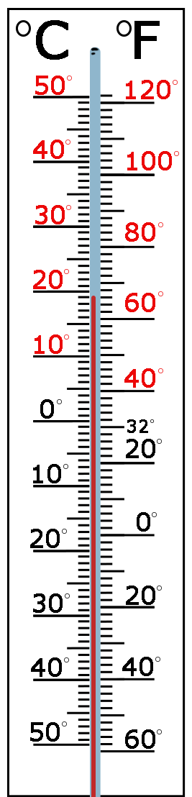
3.6.1 Warm-Up: Math Fail
A picture of a thermometer is shown.
Explain the error in the image.
Describe how to fix the image so that there is no “math fail.”
volume 1, pg. 109
Notes:
Video Link: https://algebranation.wistia.com/medias/fi4fidi5y8

Slide 7

Collaboration
volume 1, pg. 110

Slide 8

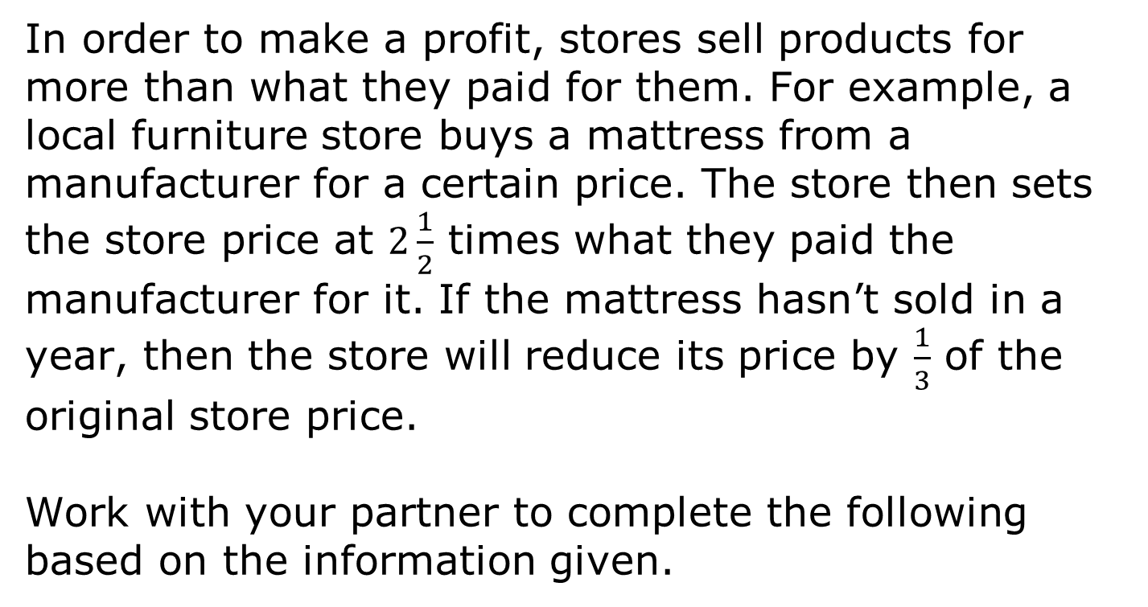
3.6.2 Collaboration: Solving a Problem with Rational Numbers
In order to make a profit, stores sell products for more than what they paid for them. For example, a local furniture store buys a mattress from a manufacturer for a certain price. The store then sets the store price at $2\frac{1}{2}$ times what they paid the manufacturer for it. If the mattress hasn’t sold in a year, then the store will reduce its price by $\frac{1}{3}$ of the original store price.
Work with your partner to complete the following based on the information given.
volume 1, pg. 110

Slide 9
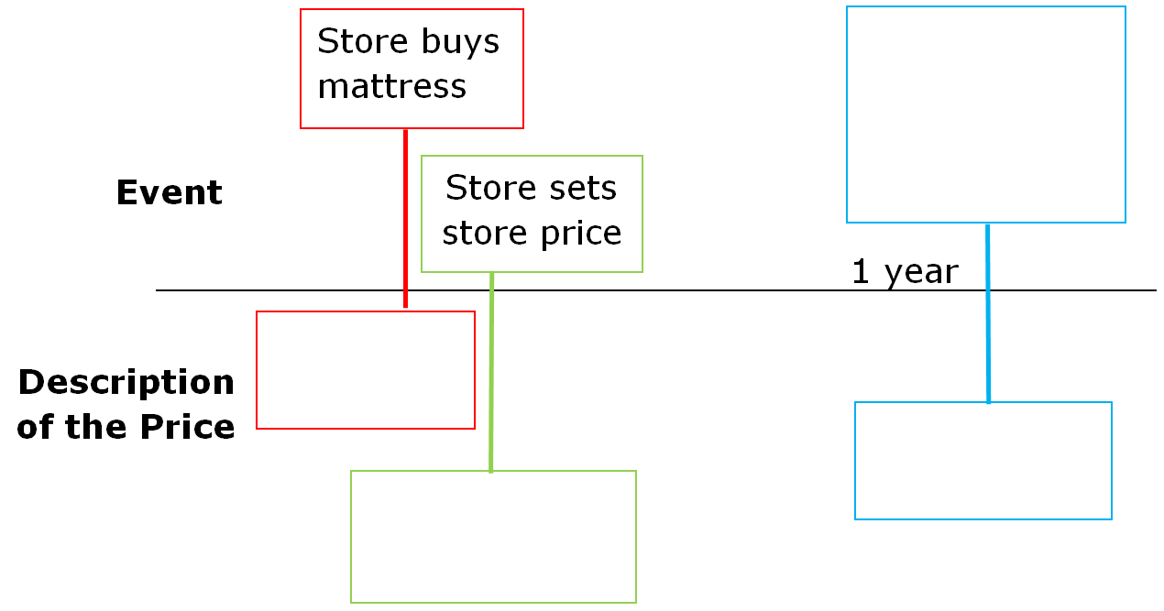
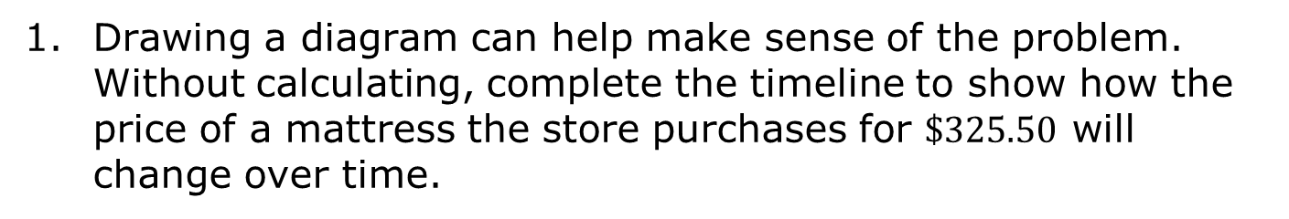
Drawing a diagram can help make sense of the problem. Without calculating, complete the timeline to show how the price of a mattress the store purchases for $\$325.50$ will change over time.
volume 1, pg. 110

Slide 10
Explain whether the store’s first price will be greater than or less than the price they paid the manufacturer.
What is the first price the store will set for the mattress?
volume 1, pg. 110

Slide 11
Explain whether the price after a year will be greater than or less than the store’s first price.
What is the sale price of the mattress after one year?
If the store sells the mattress after one year, explain if the store will make or lose money on the mattress.
volume 1, pg. 110

Slide 12

Guided Instruction
volume 1, pg. 111

Slide 13

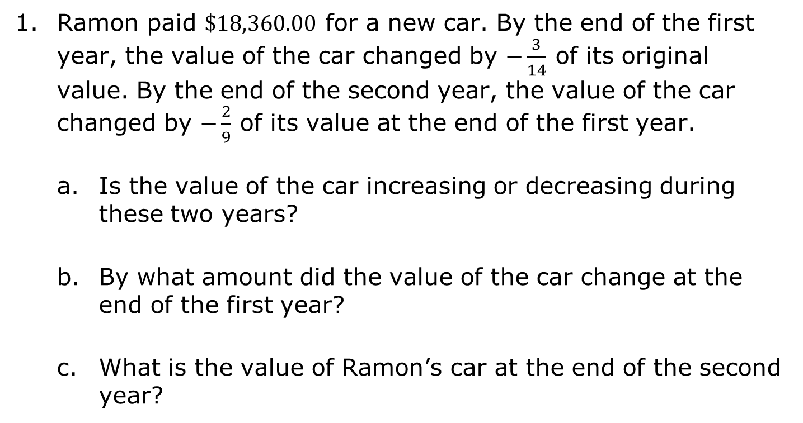
3.6.3 Guided Instruction: Solving Real-World Problems with Rational Numbers
Ramon paid $\$18,360.00$ for a new car. By the end of the first year, the value of the car changed by $−\frac{3}{14}$ of its original value. By the end of the second year, the value of the car changed by $−\frac{2}{9}$ of its value at the end of the first year.
Is the value of the car increasing or decreasing during these two years?
By what amount did the value of the car change at the end of the first year?
What is the value of Ramon’s car at the end of the second year?
volume 1, pg. 111

Slide 14
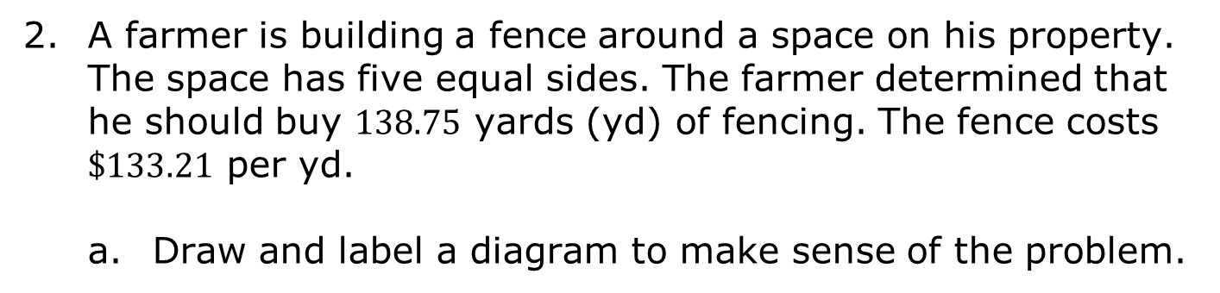
A farmer is building a fence around a space on his property. The space has five equal sides. The farmer determined that he should buy $138.75$ yards (yd) of fencing. The fence costs $\$133.21$ per yd.
Draw and label a diagram to make sense of the problem.
volume 1, pg. 111

Slide 15
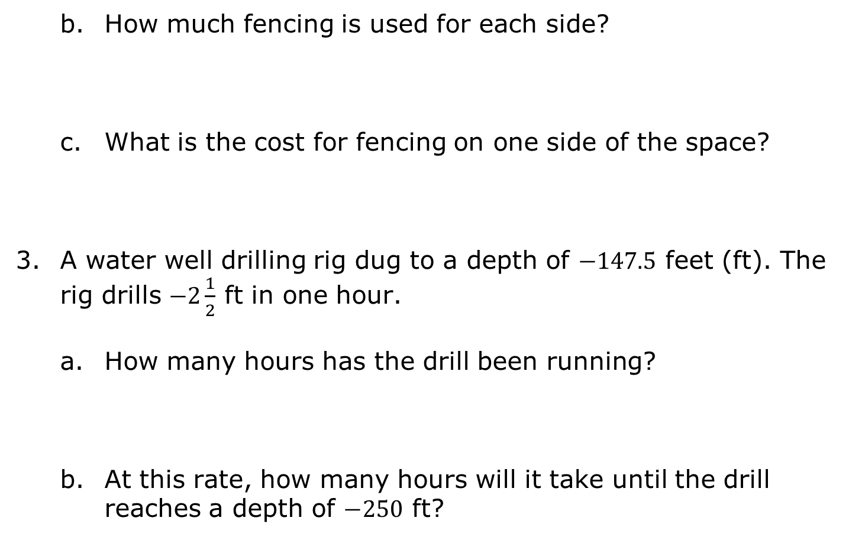
How much fencing is used for each side?
What is the cost for fencing on one side of the space?
A water well drilling rig dug to a depth of $−147.5$ feet (ft). The rig drills $−2\frac{1}{2}$ ft in one hour.
How many hours has the drill been running?
At this rate, how many hours will it take until the drill reaches a depth of $−250$ ft?
volume 1, pg. 111

Slide 16
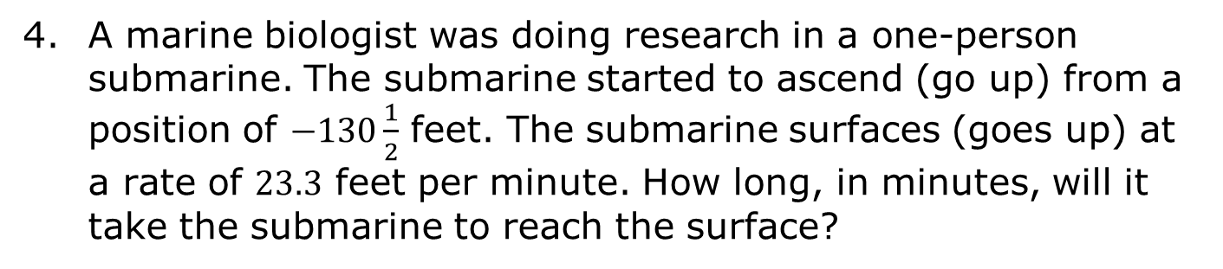
A marine biologist was doing research in a one-person submarine. The submarine started to ascend (go up) from a position of $−130\frac{1}{2}$ feet. The submarine surfaces (goes up) at a rate of $23.3$ feet per minute. How long, in minutes, will it take the submarine to reach the surface?
volume 1, pg. 112

Slide 17

Your Turn
volume 1, pg. 112

Slide 18
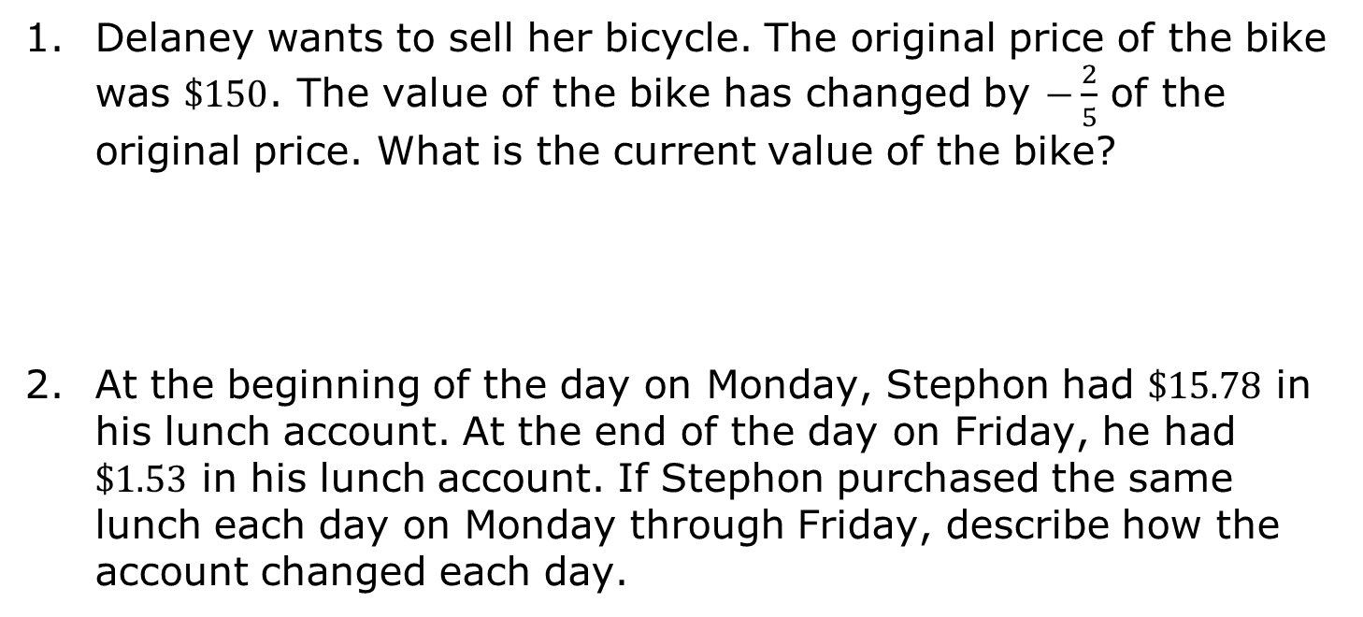
3.6.4 Your Turn!
Delaney wants to sell her bicycle. The original price of the bike was $\$150$. The value of the bike has changed by $−\frac{2}{5}$ of the original price. What is the current value of the bike?
At the beginning of the day on Monday, Stephon had $\$15.78$ in his lunch account. At the end of the day on Friday, he had $\$1.53$ in his lunch account. If Stephon purchased the same lunch each day on Monday through Friday, describe how the account changed each day.
volume 1, pg. 112

Slide 19

Wrap-Up
volume 1, pg. 113

Slide 20
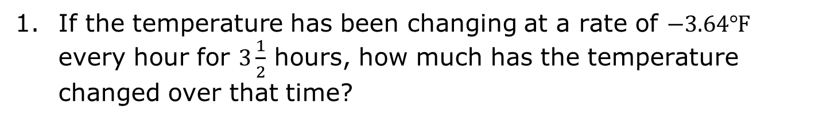
3.6.5 Wrap-Up: Ticket Out the Door
If the temperature has been changing at a rate of $−3.64$℉ every hour for $3\frac{1}{2}$ hours, how much has the temperature changed over that time?
volume 1, pg. 113

